Slide 1
ATAC buses analysis
From 20 march to 30 june
Diego Sonaglia

Slide 2
The project:
Dataset
  Around 20 Gb of (compressed ) html pages crawled from atac website each 15 minutes
Goal
  Find Out if Atac’s buses lateness is related to traffic
Approach:
  Parse raw data into a compact SQL database and then use it to retrieve metrics
Problems:
  Locate Useful data in the html pages
  Data Size / Parsing Time
  Data Granularity
  Data Noise
  Finding a meaningful metric

Slide 3



Approach
Html Pages
Plots / Metrics
SQL Database

Slide 4
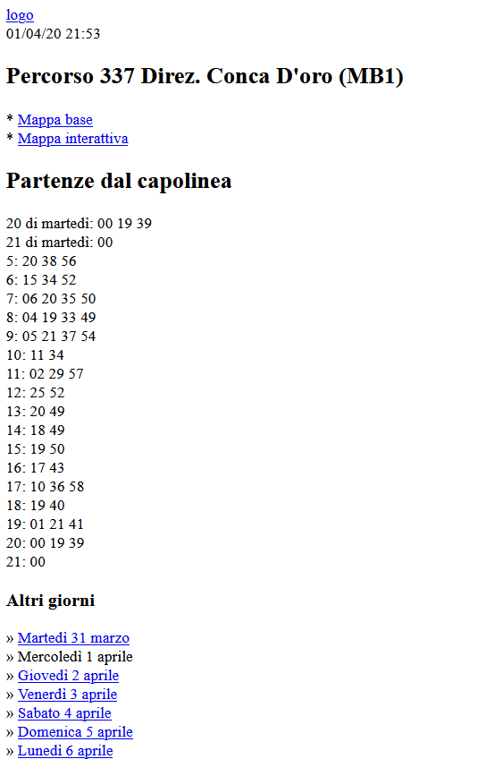
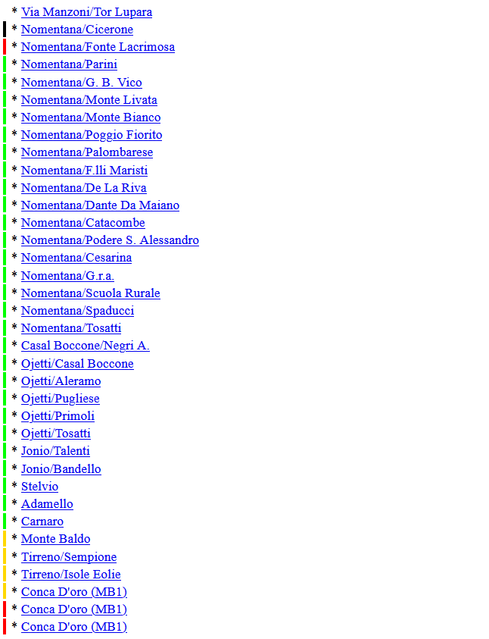
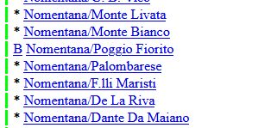
Locate data
Sequence of stops for a route
Bus Position
Daily scheduled departures
Traffic State

Slide 5

Locate data 2
Route Id
Bus Id

Slide 6
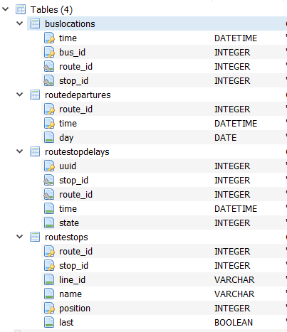
Sqlite Database

Slide 7
Data Size / Parsing Time
Problem
The dataset is quite heavy, extracting , moving or deleting the pages can take hours !
Parsing the whole dataset can take days and one error may force to restart from the beginning
My solution:
Parse one bus line at a time, directly reading from the archive without extracting it with winrar library and parsing the html pages with beautifulsoup4
Parsing all the days from one line takes 20-30 minutes this way
Allows for short parsing / analysis / validation cycles

Slide 8
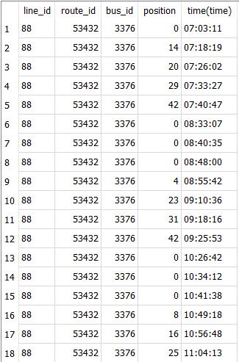
Data Granularity
As we can see 15 minutes is a long time, a bus can perform up to 10/20 stops in that time
Buses appears on the first stop of the line several times before it actually departs
Possible solution:
  Interpolation
  Using metrics that are meaningful with the granularity level we have

Slide 9
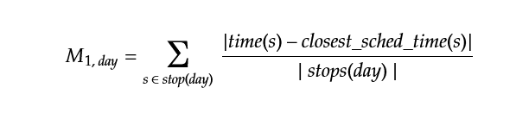
Possible metric 1 (Average Lateness from scheduled arrival)
Idea: find the average difference between scheduled arrival time and actual arrival time
Problems:
  Finding a valid arrival schedule for each stop and each day
    Atac doesn’t seem to provide one
    Third party may derive it from other metrics
  Data only show when bus is close to a stop, even if it has not actually stopped
  Data granularity is 15 minutes
Appears to be fragile

Slide 10
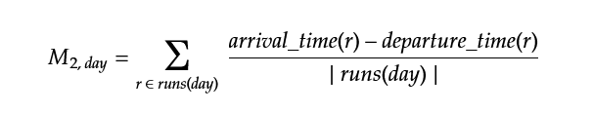
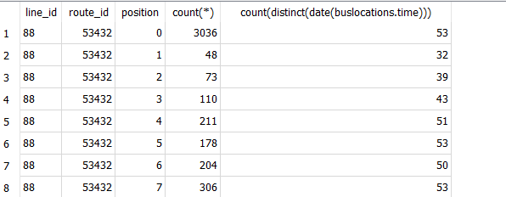
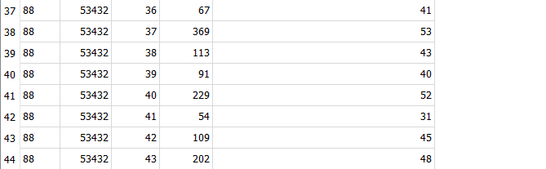
Possible metric 2 (End to end average time)
End to End time:
  Time required to travel from one end to the other of a route,
Problems:
  We need to find a bus on both ends
  Dataset is somehow unbalanced
  under this point of view

Slide 11
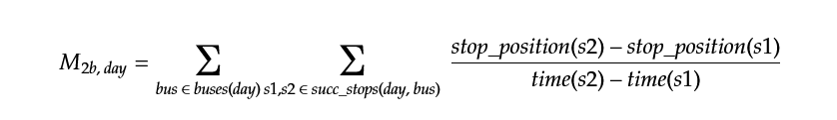
Possible metric 2b
(Average Speed stops/10min)
s1
s2
s3
...
Avg speed measured in stops
  Basic Idea: a bus has to perform all the stops of a certain line after each departure, so we can basically take each successive stops and measure the average speed in each second (or each 10 minutes)

Slide 12
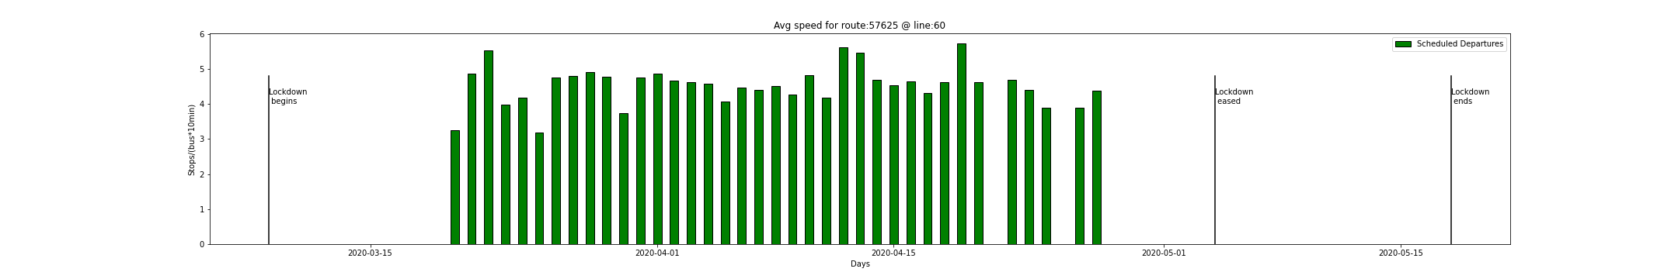
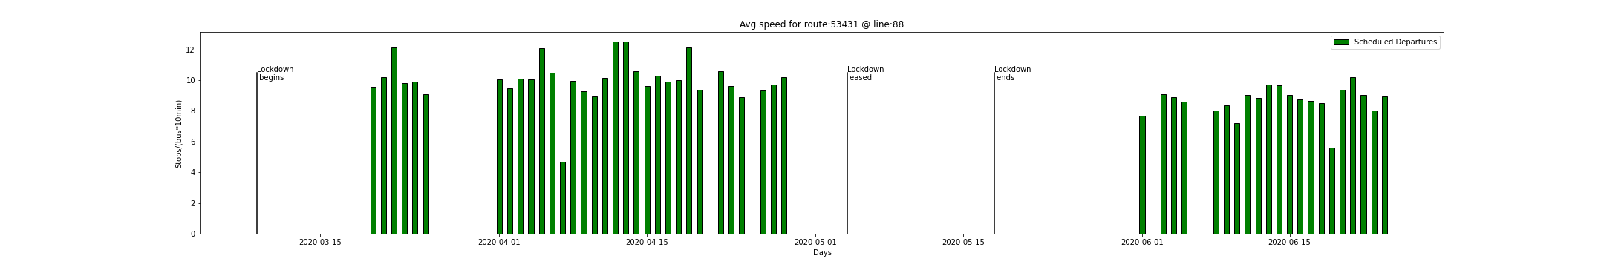
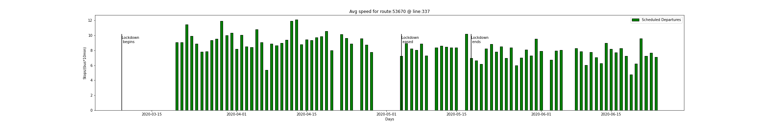
Plots for 2b (Average Speed stops/10min )

Slide 13
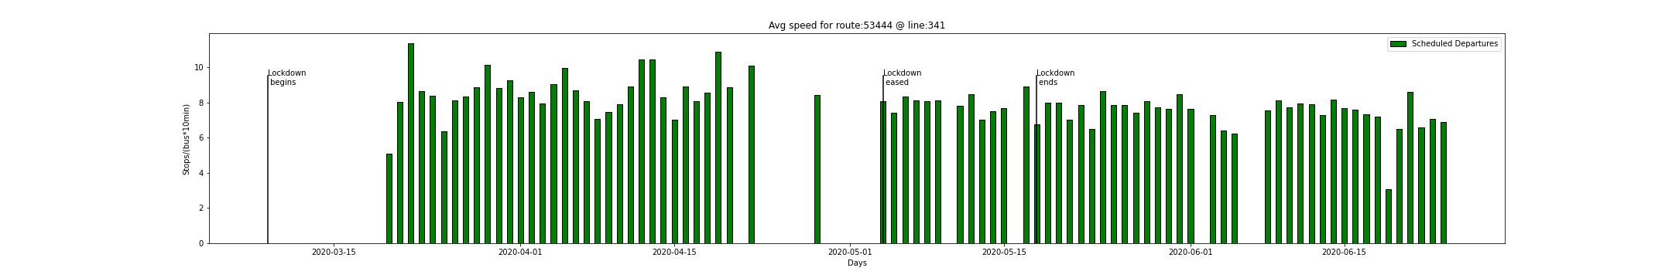
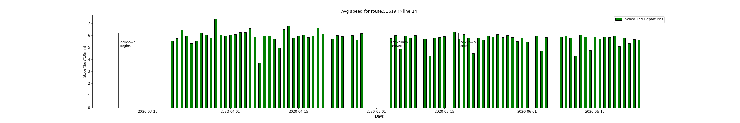
Plots for 2b (Average Speed stops/10min )
Observations:
  Routes can change over time
  Some of them are shown as unavailable, others as not existing, for other there are just no pages for a certain day
  Doesn’t seem to be meaningful

Slide 14
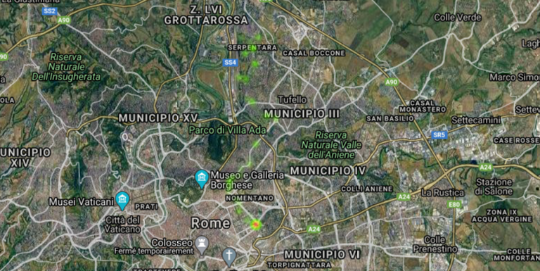
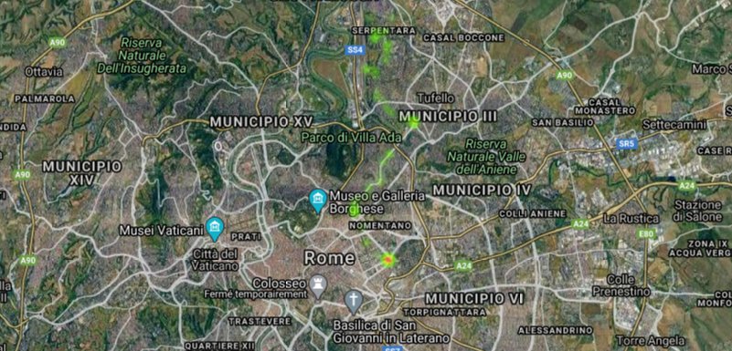
Possible metric 3 (Bus Locations Heatmap)
Line 14 before lockdown
Line 14 after lockdown

Slide 15
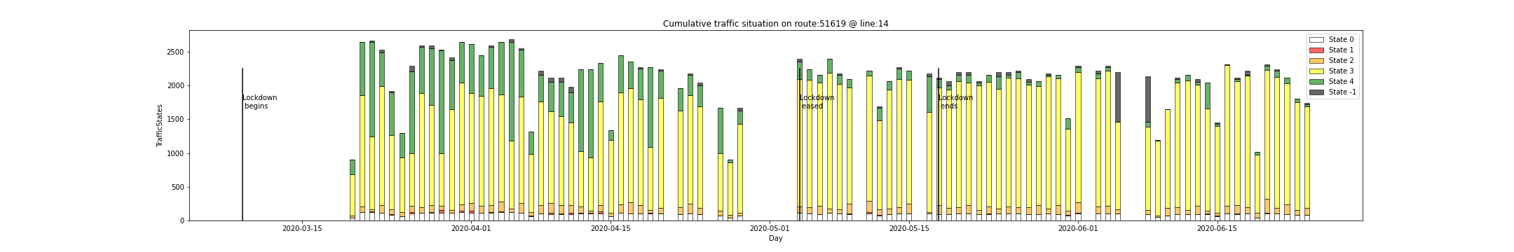
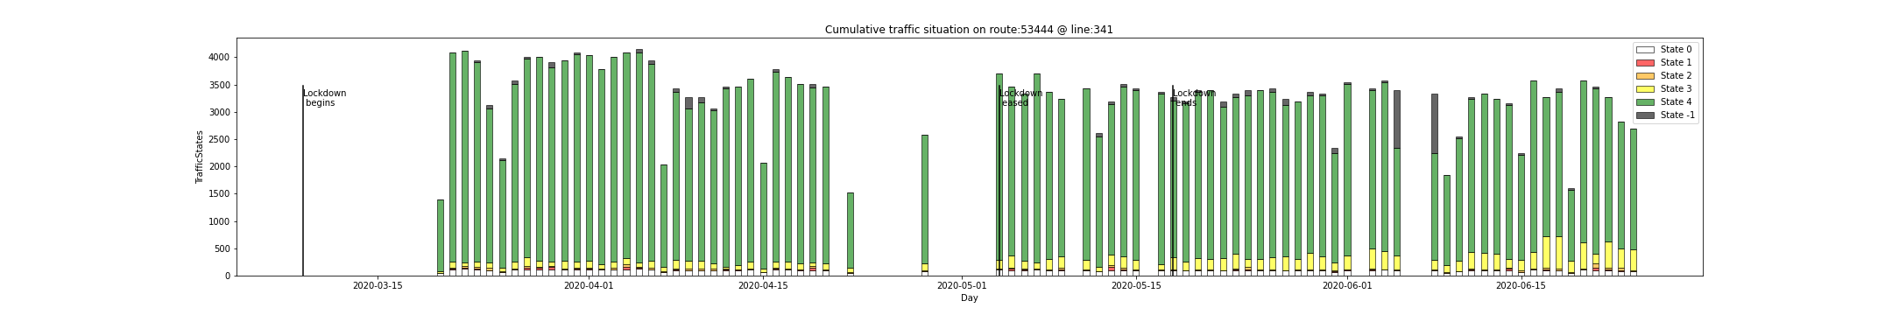
Possible metric 4 (Daily cumulative traffic state)
Idea: using the state indicator from the html pages to retrieve the traffic conditions
Observations:
  This metric clearly shows the impact that lockdown had on traffic, and how much it impacted more the central lines compared to the periferic ones

Slide 16
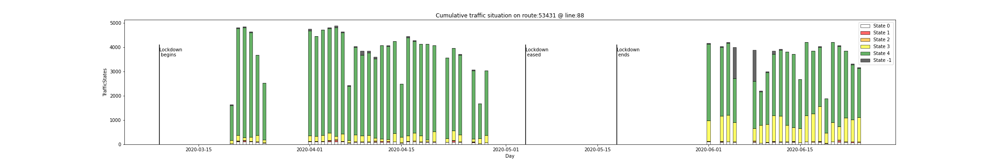
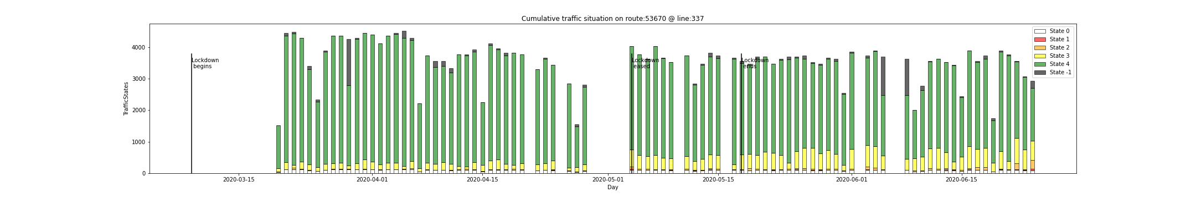
Possible metric 4 (Daily cumulative traffic state)

Slide 17

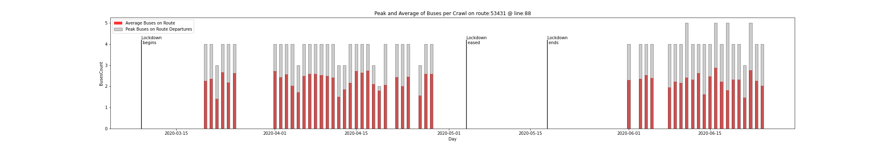
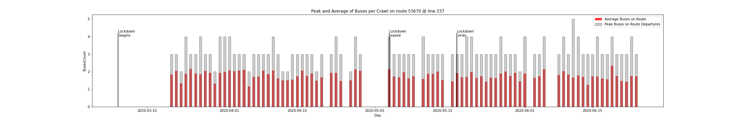
Possible metric 5 (Average number of buses on route)
Idea: extract average/maximum number of buses we see on a certain route for a given day to have an esteem how many buses were assigned to a certain route

Slide 18
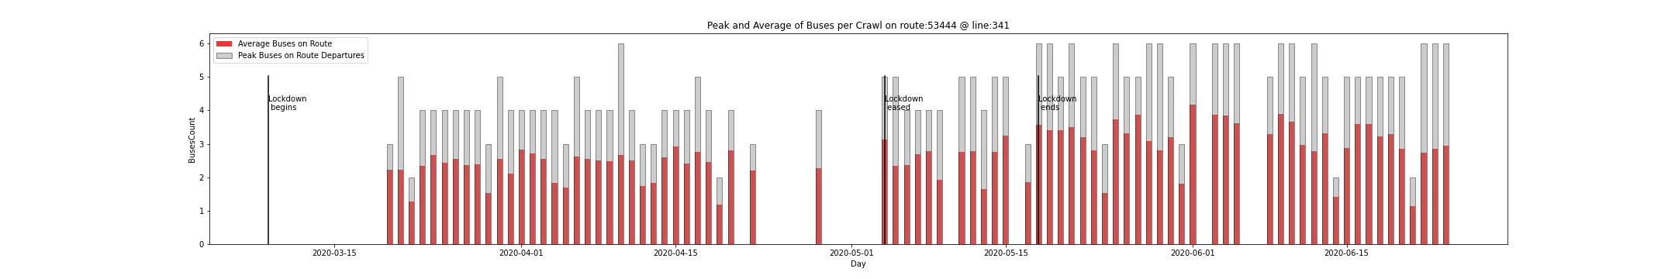
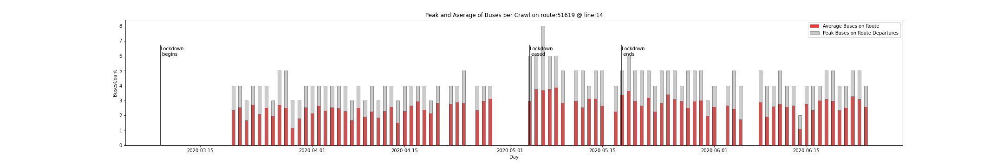
Observation:
  The number of buses seen on one line at the same time generally increases after lockdown
  It can due either to the traffic or to an increase in departures, how to find out which one was ?

Slide 19
Possible metric 5 (Actual vs Expected Daily Departures)
Does not suffer from granularity problem. (Unless a route is completed in less than 15 minutes)
Easy to compute (once you figure out)
Basically we can just scan the ordered list of positions and look for overflows

Slide 20
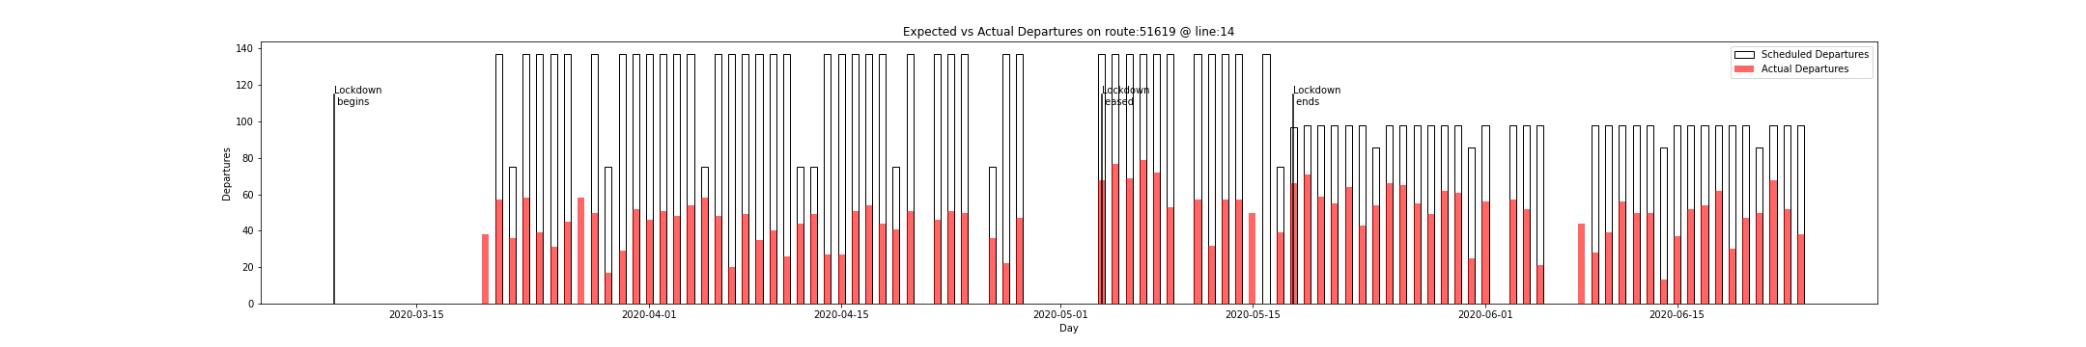
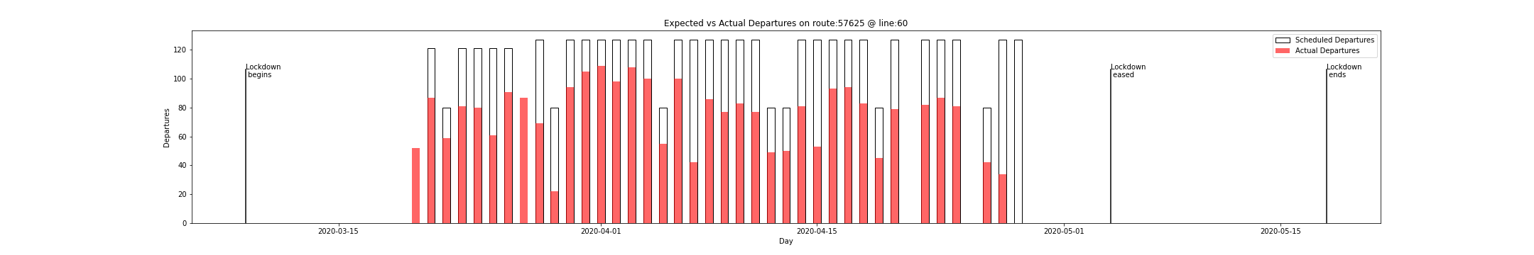
Possible metric 6 (Actual vs Expected Daily Departures)

Slide 21
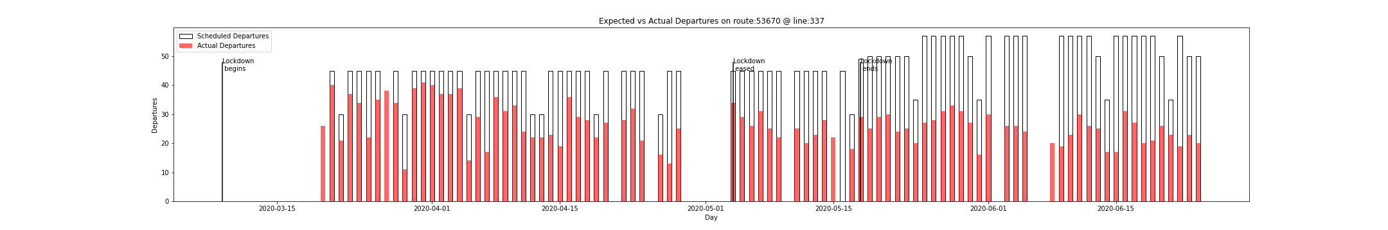
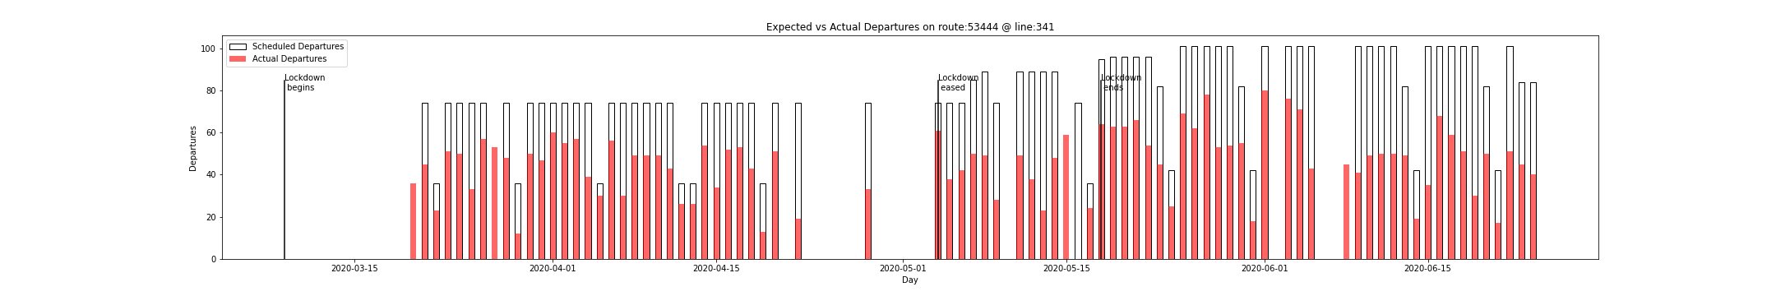
Observations:
This metric looks extremely interesting !
Actual and Scheduled departures have signficative differences between different routes
It looks like that promised changes in departures do not reflect real ones

Slide 22
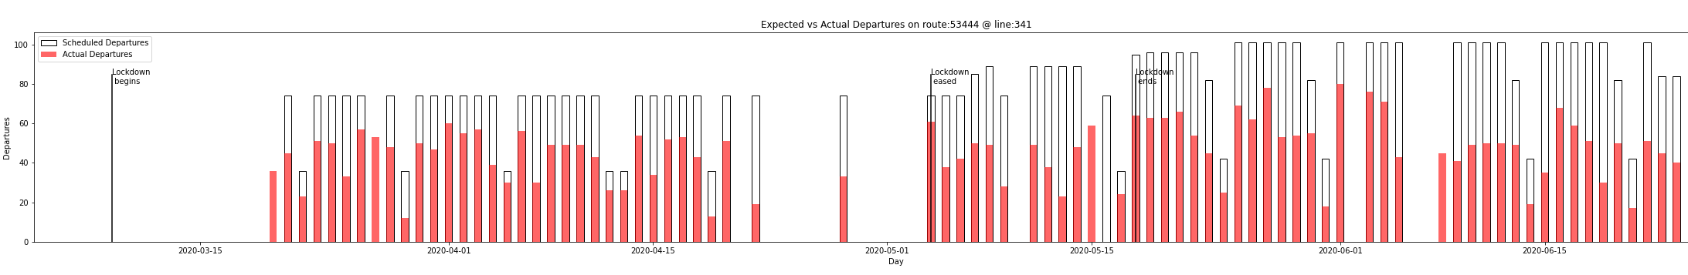
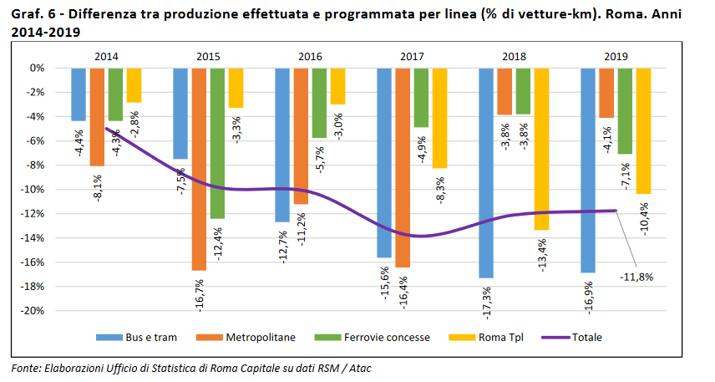
Final considerations
Atac states that they can guarantee more than 80 % of the departures in 2019, but this preliminary analysis show that this numbers may be inflated or that performance worsened this year
Link to reference

Slide 23
Further Improvements
Parse the whole database
Extract global version of the above metrics
Modify the scraper to parse the reason of page unavailability
Investigate more on the difference between scheduled and actual departures

Slide 24
Thanks for the attention

